Slide 1

Video Anomaly Detection – Design Notes

Slide 2
Data_Loader
Data_Loader
Reads all videos in the data folder and builds a MultiZipVideoDataset
dataset: MultiZipVideoDataset
dataloader: torch.utils.data.DataLoader(dataset, batch_size=1, shuffle=True)
zip_file_paths = [os.path.normpath(r'C:\\Users\\karthik.venkat\\PycharmProjects\\video_anomaly_detection\\data\\Anomaly-Videos-Part-1.zip'), os.path.normpath(r'C:\\Users\\karthik.venkat\\PycharmProjects\\video_anomaly_detection\\data\\Anomaly-Videos-Part-2.zip'), os.path.normpath(r'C:\\Users\\karthik.venkat\\PycharmProjects\\video_anomaly_detection\\data\\Training-Normal-Videos-Part-1.zip') ]
Iterator and dataset.samples attribute returns vidoes as numpy arrays

Slide 3
Load_video_from_dataset
dataset = MultiZipVideoDataset(zip_file_paths=zip_file_paths, transform=None) dataloader = torch.utils.data.DataLoader(dataset, batch_size=32, shuffle=True) samples = dataset.samples

Slide 4
Parse_data_loader
For a given Data_Loader, passes each video through R3D
extracts penultimate features
Saves feature to processed folder

Slide 5
Key Components and Utilities in the ML Pipeline - 1
parse_log
Run_sk_loader
Load_train_list
Run_model_with_weights
Read the log file created the video parsers (Data_Loader) to determine which video files errored out during the feature extraction process (generating .pt file). This happens mostly due to out of memory.
For a given folder path where the processed features are present, this class sets up the X_train, y_train, X_val and Y_val.
Update the folder_array to use this class
Loads the list of training and test videos from text files provided with the dataset
The text files define the specific testing and training videos to use.
For a set of .pt feature files, runs the R3d model and obtains the final 400 element scores and the predicted class.
Is Used By
Is Used By
Naïve_classifier_all_files
Naïve_classifier
Trains and Infers a XGBoost Classifiers to load train and validation (20% of files) from the FULL data set
Same as the all_files classifier. Only the folder_array and the target labels are different (as the name of the normal class folder is different from the ‘all_files’ version.

Slide 6
Key Components and Utilities in the ML Pipeline - 2
Split_video
Split_video_variant_1
Split_video_variant_2
Uses the start and end times of anomalies within the testing videos as provided in the data set, to split each anomaly video into
- start_1 – normal segment within anomalos video
- anomaly_1 – anomalous segment within anomaly video
- End_1 – normal segment within anomaly video
- start_2 – if a second anomaly is present, and so on
Same as the one on the left, except that:
- start_1 – from start of video till end of anomaly segment
Purpose – to test the hypothesis that the classifier is picking up on the shift from normal to anomalous segment within the video
Same as the one on the left, except that:
- start_1 – from start of video till end of anomaly segment
Purpose – to test the hypothesis that the classifier is picking up on the shift from normal to anomalous segment within the video

Slide 7
Architecture of XGBoost anomaly classifier
Data Loader
Data Loader Parser
R3D Pre-Trained Network
Parametric Classifier (Gradient Boost)
Normal Video
Generate and write Feature Tensor to Disk
Read Feature Tensor and Train Classifier
Anomaly Video
r3d_18_feature_extraction.py
naïve_classifier.py
Data_Loader.py
parse_data_loader.py
512 element tensor for each video stored as .pt file
Training and Testing videos in Zip files

Slide 8
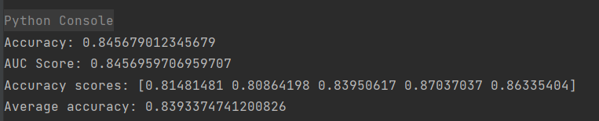
Current Results – with R3D-18 feature extraction and SVM classifier - Partial Data set

Slide 9
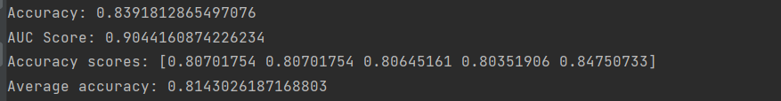
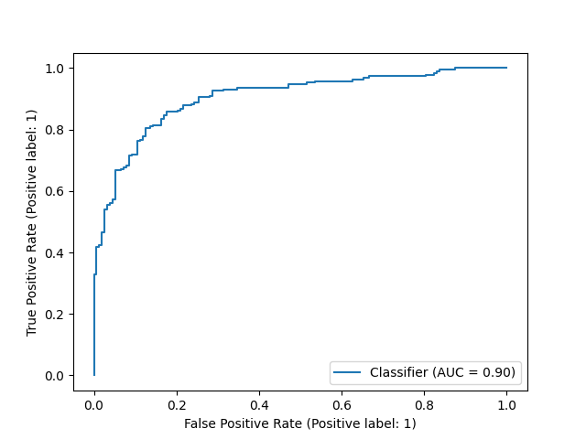
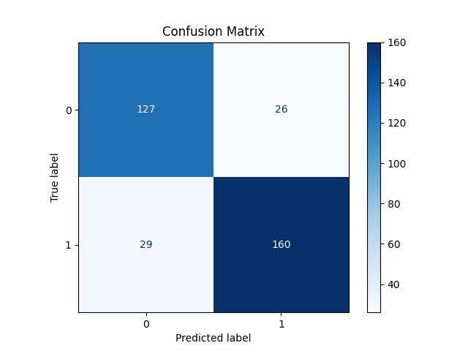
Performance: Full data set (using a 20% validation set on the full data set)

Slide 10
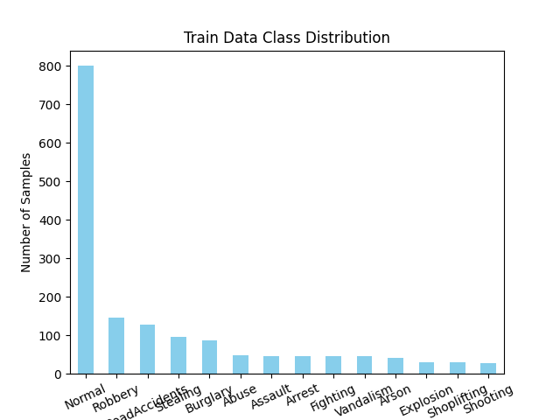
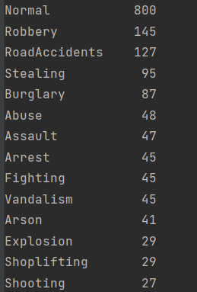
Training Data Distribution
Total: 1610. Normal is approx. 50%

Slide 11
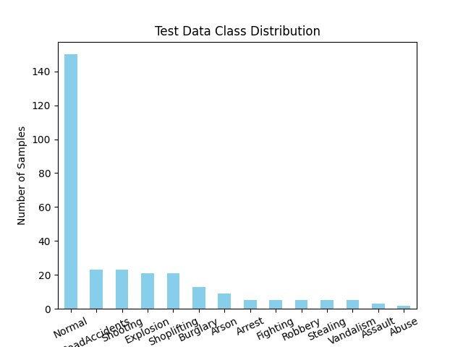
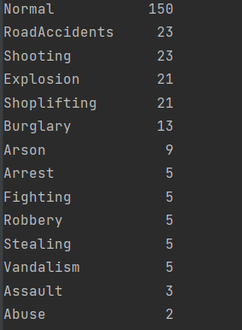
Test data distribution

Slide 12
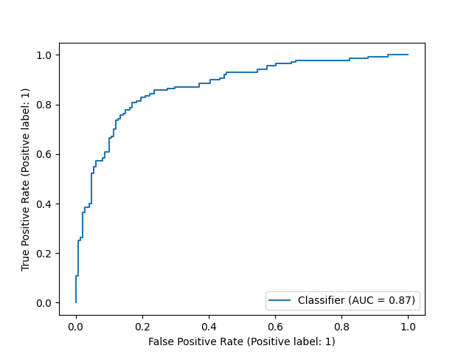
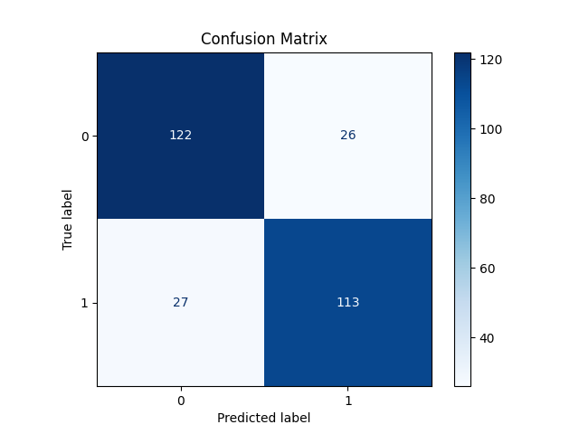
Performance – Segregated data set (using train and test list provided in the data set)

Slide 13
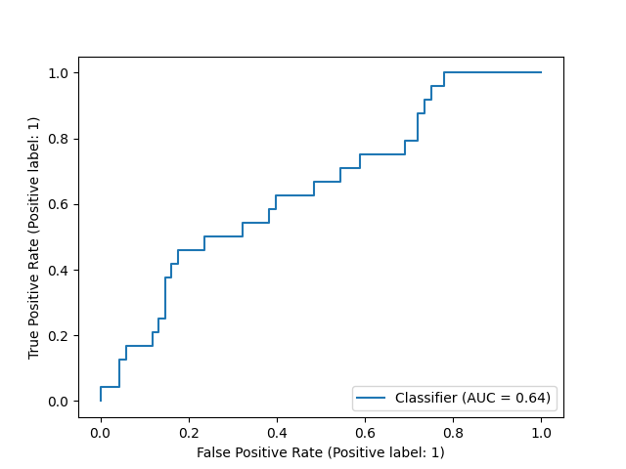
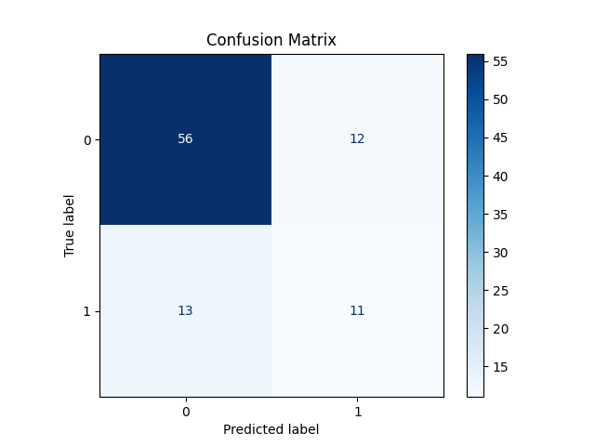
Results after splitting the Test Videos into Normal and Anomalous segments
{'abuse': 2.0,
'arrest': 5.0,
'arson': 10.0, 'assault': 4.0, 'burglary': 15.0, 'explosion': 22.0, 'fighting': 5.0, 'normal': 304.0, 'roadaccidents': 23.0, 'robbery': 5.0, 'shooting': 25.0, 'shoplifting': 25.0, 'stealing': 7.0, 'vandalism': 8.0}
92 samples in validation set above (20% of data set)
High ability to detect normal classes
Poor ability on anomaly detection
Total: 460

Slide 14
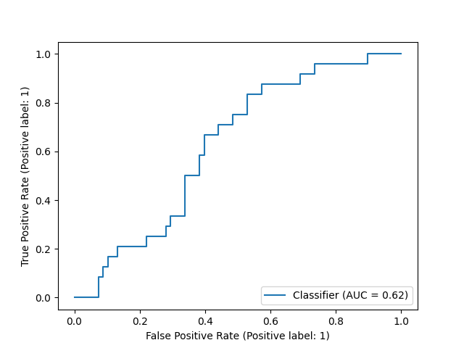
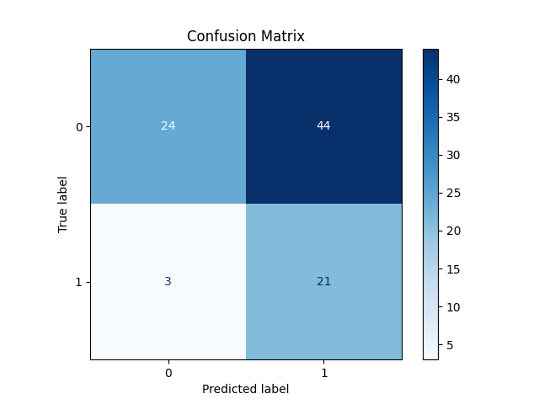
Using a classifier that is trained on the full data set – and tested it on the split test videos
92 samples in validation set above (20% of data set)
Ability to detect anomaly dramatically improves
But so does the false positive rate

Slide 15
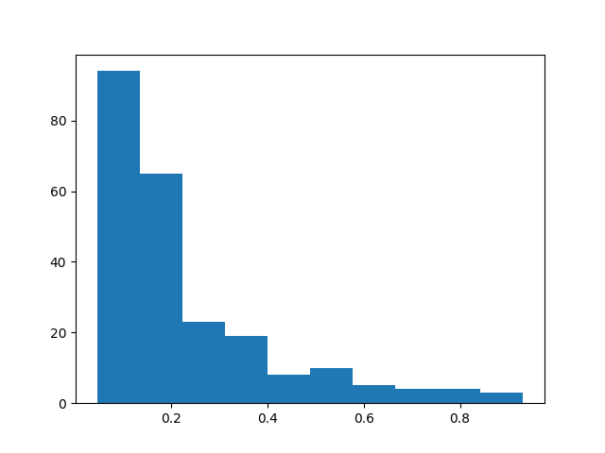
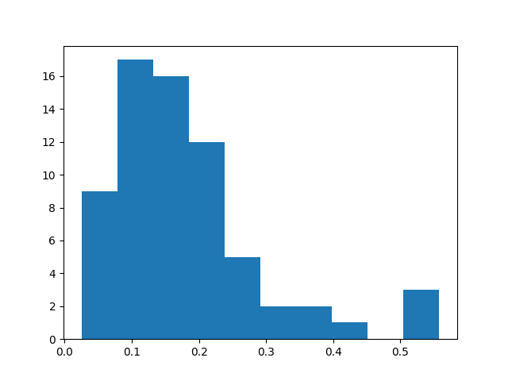
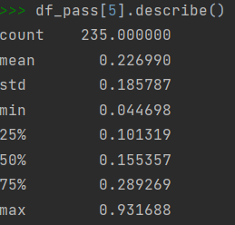
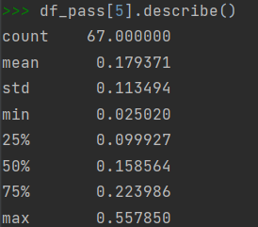
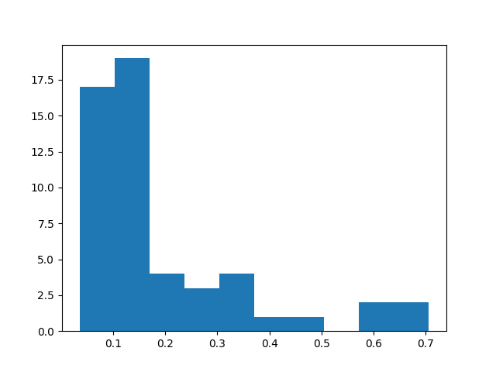
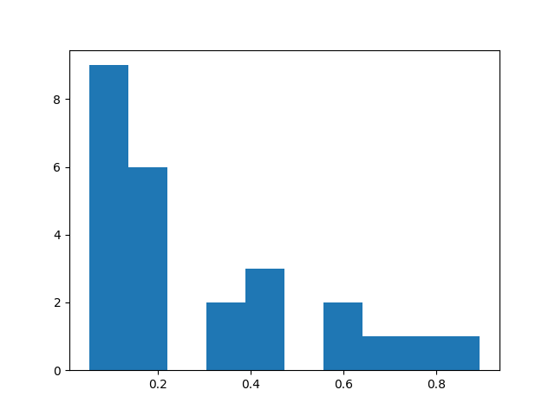
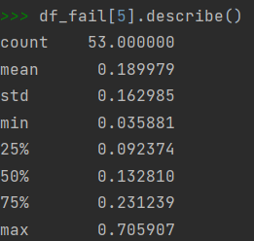
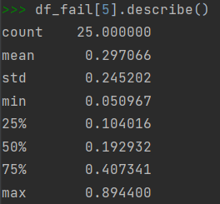
Analysis of feature extractor activity classification probability scores in both cases
HIGH AUC – FULL DATA SET
LOWER AUC – TEST DATA SET – SPLIT VIDEOS

Slide 16
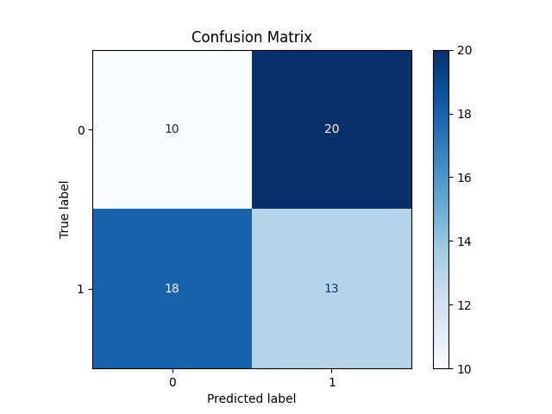
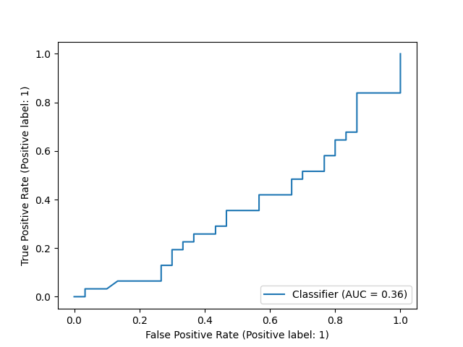
Variant 1: Option 1 (classifier trained on variant 1 data set)

Slide 17
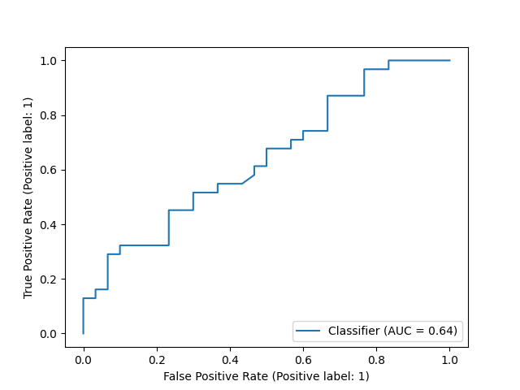
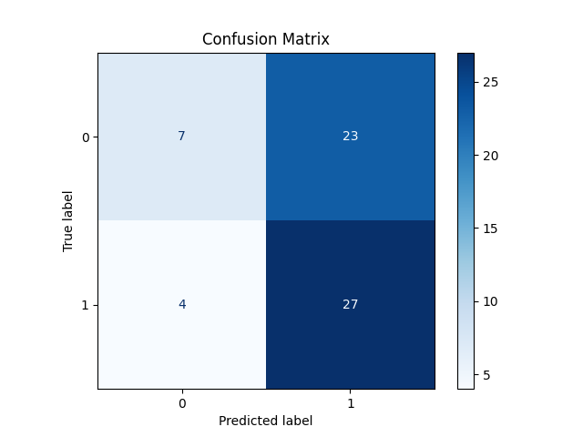
Variant 1: Option 2 (pre-trained full data classifier)

Slide 18
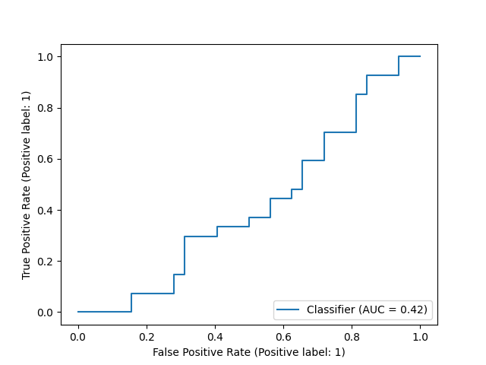
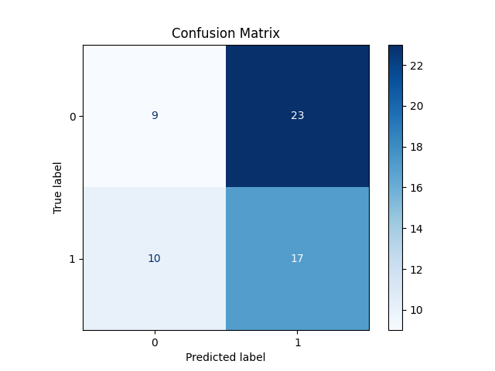
Variant 2: classifier trained on variant 2 Data set
Number of videos in each class: {'abuse': 2.0, 'arrest': 5.0, 'arson': 10.0, 'assault': 4.0, 'burglary': 15.0, 'explosion': 22.0, 'fighting': 5.0, 'normal': 139.0, 'roadaccidents': 23.0, 'robbery': 5.0, 'shooting': 25.0, 'shoplifting': 25.0, 'stealing': 7.0, 'vandalism': 8.0}
Anomalous: Normal = 156:139

Slide 19
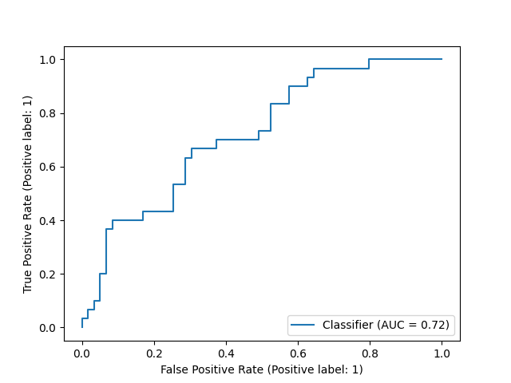
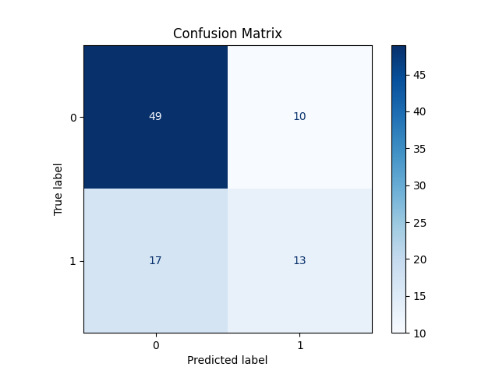
Variant 2: with the full normal video test set back in (newly classifier)
{'abuse': 2.0, 'arrest': 5.0, 'arson': 10.0, 'assault': 4.0, 'burglary': 15.0, 'explosion': 22.0, 'fighting': 5.0, 'normal': 139.0, 'roadaccidents': 23.0, 'robbery': 5.0, 'shooting': 25.0, 'shoplifting': 25.0, 'stealing': 7.0, 'testing_normal_videos_anomaly': 148.0, 'vandalism': 8.0}
Anomalous: Normal = 156:(139+148)=156:287 (double the number of normal videos)

Slide 20
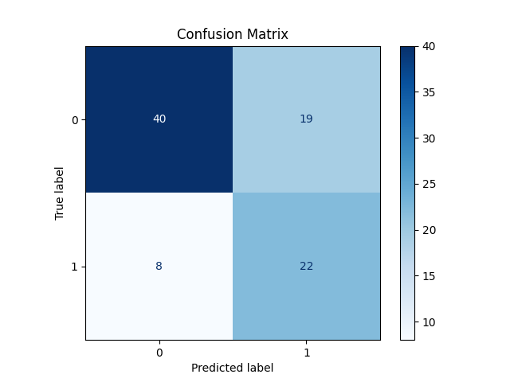
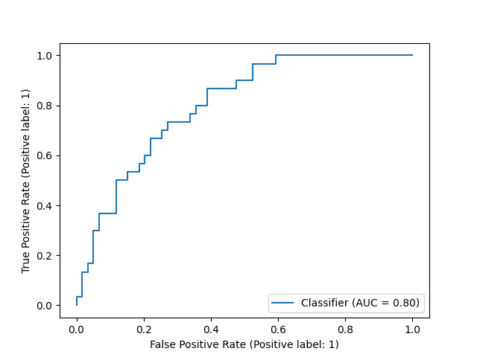
Variant 2: Added the full normal set back in (preloaded classifier)
RE-PRODUCED THE ORIGINAL ACCURACY AS SEEN WITH THE FULL DATA SET!

Slide 21
Futher steps:
Fix error in Variant 1 split video logic – when video has two anomalies – and rerun the test results
Fix the same possible error, the regular video split as well.
Repeat the process for all variants – and reconfirm results
Increase frame sampling rate and assess performance
In the full_classifier, remove the provided test videos, and only train on the training set (without using the validation set – and test on the test videos provided in the test video list.

Slide 22
Discussion with Pravesh – 11/17
- Analyze the results from both architectures
Architecture 1
Architecture 2
Graph of data set size vs AUC, specificity and sensitivity
- Take away the Bags in Arch 2 – and see if the performance stays the same at a video level.
Questions to answer:
Why is the simple architecture beating the state of the art?
Is bagging really necessary to achieve 85%+ AUC?

Slide 23
Interim Conclusions to be expanded
Size of data set matters when training the classifier. At least 400 samples provider better results
Can this result be further analyzed and an initial paper be produced?

Slide 24
Architecture 2 – Inception 3D Features with FC NN (Vector Bootcamp)
Reused Inception 3D Feature Vector: (1620, 32, 2048) for training an XGBoost Classifier
810 anomaly classes, 810 normal videos = 1620 training samples
Each video with 32 segments
Each segment with 1024 RGB Features and 1024 Flow Features = 2048 Feature
Training started 5:21 PM, 11/25… still running… ended after 3 hours!
main_single_script
To do:
Feature extractor not available. Develop one to extract features at a Video level and not segment level → to compare performance
Find a way to reduce 32*2048 features to a smaller number

Slide 25
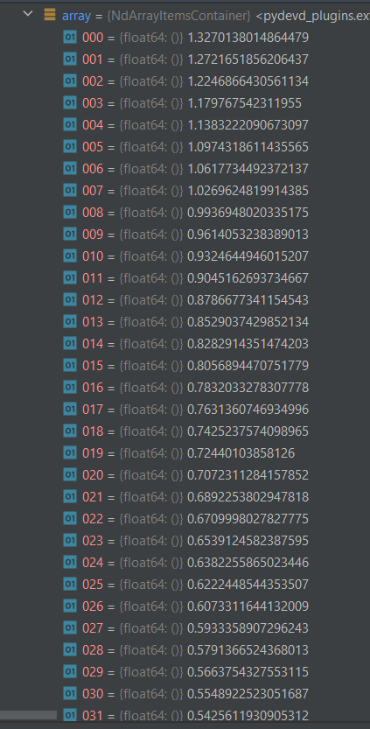
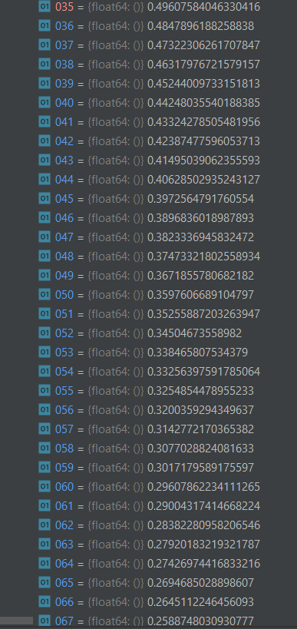
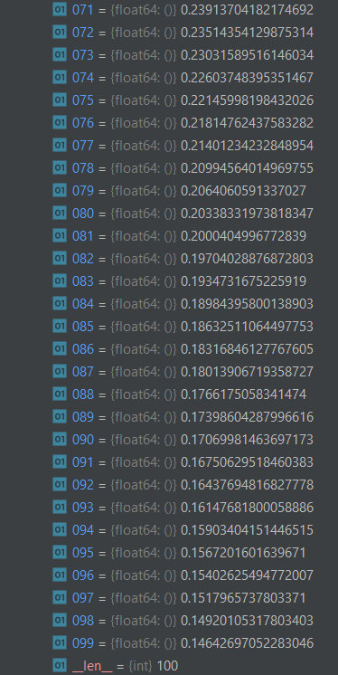
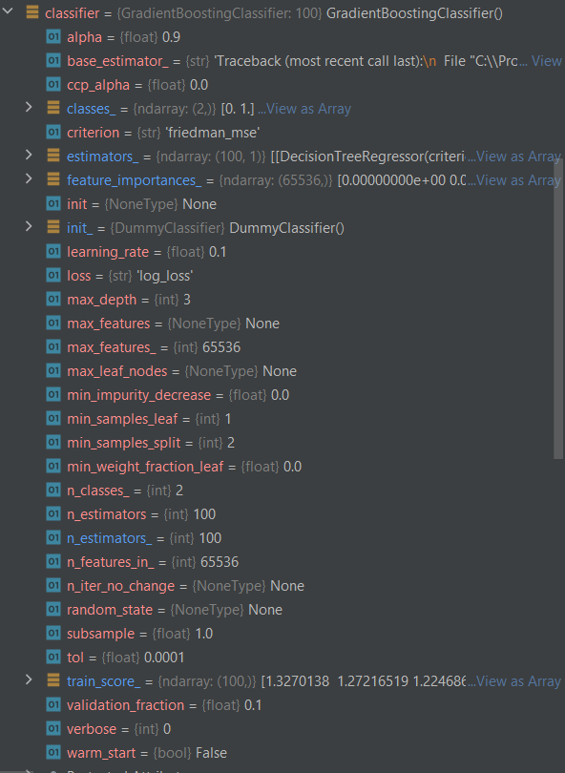
Approach 2: Results from Gradient Boost Classifier

Slide 26

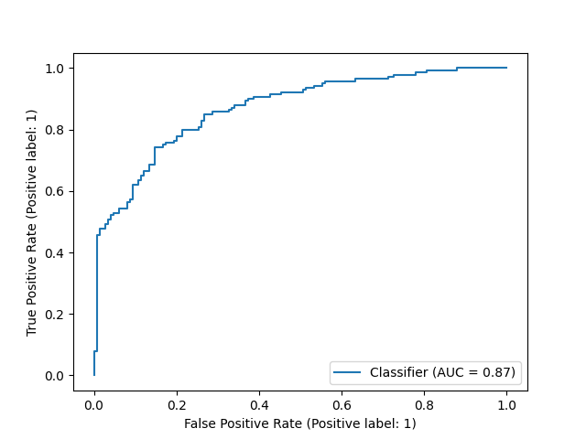
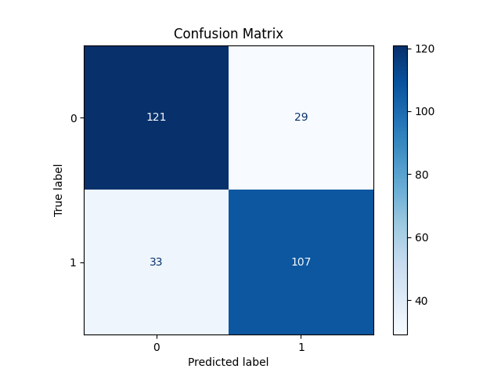
Approach 2: Results on Test Set

Slide 27
Variant 3: Run classifier on the Full videos within the Testing Set Only (290 test videos) - No splitting of each video

Slide 28
EFFECTS OF INCREASING THE FRAME SAMPLING RATE FROM CURRENT 5:1 TO 3:1 AND THEN 1:1

Slide 29
Areas to investigate based on the current results
Why is the full video classifier performing better than the extracted segment classifier
Is the learning from the video attributes/metadata rather than the video contents?
Is it the shorter nature of the extracted segment that is resulting in poorer results?
Only 1 in 5 frames is used for the feature extraction model. Increase this to all frames to check of classification accuracy improves
Number of videos may not be the reason as even the previous classifier (on full video) performance as bad as the new classifier (the one trained on extracted segments).

Slide 30
Findings from Feature Analysis
Segrated data set
Full Data Set
Average activity prediction score by feature extraction model is lower for incorrectly classified anomalies
Ccfff

Slide 31
Relationship between Extracted Features and Anomaly Indicators

Slide 32
Design Options to incorporate
Pre-Processing
Include full set of anomalies and normal videos as used in Sultani baseline
Use exact same videos for testing and training – Verify the pipeline.
Use Video Attention model to generate embeddings for anomalous segments
Learning Model Architecture
Build in Weakly Supervised Regression model instead of SVM classifier
Can a Transformer style architecture be used?
How to use attention from a transformer in the weakly supervised setting? ViT input is video slices, but trained to give video classification overall, does attention over the slices localise the anomaly? Is there a way to incorporate the pos/neg bagging process from the older method?
Clip out the normal segment from the anomalous segment and run it through the model – see if it classifies it as normal
Check the loader is not messing up the classes.
Will shorter videos have better results than longer videos?
Look at features comparison after the pre-processing
Replicate the bag based baseline

Slide 33
Ideas
Frames within Videos and Slices within Frames to localize the anomaly – use attention over the slices
Integrate attention into the weakly supervised learning process

Slide 34
Feature extraction Options for I3D
I3D by Deepmind available in TF Hub, now in Kaggle. Not a fine tunable version.
Loaded via TF Hub, wrapped a Keras classifier to it, but cannot do feature extraction?
Any other way to do it in Keras?
Use the Deep Mind version?
Load the model in Keras and then the weights from Kaggle? What really are the model files in Kaggle
Use a Pytorch version developed by others
Specifically run a feature extractor written by others?

Slide 35
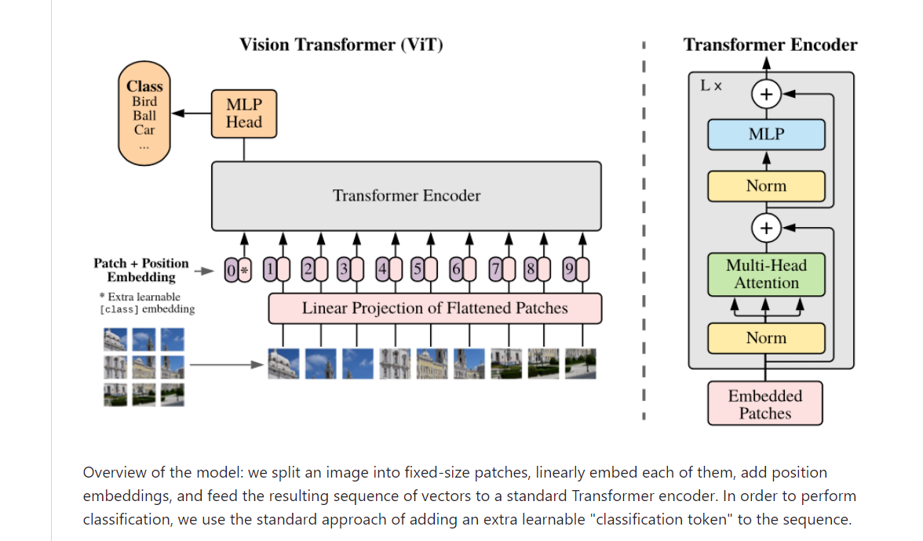

Slide 36
Transformer for Video - Notes
Video classification with transformers
addes positional embeddings to CNN feature maps
Uses the transformer for classification
https://keras.io/examples/vision/video_transformers/

Slide 37
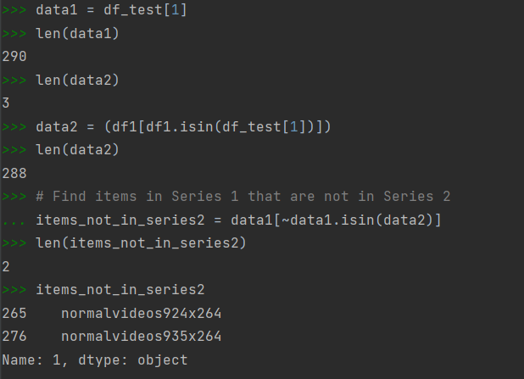
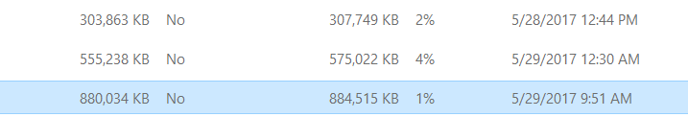
Files larger than 500MB don’t get processed

Slide 38
Title of presentation
Secondary title
Name
Name
Department
Institution
Month XX, 20XX

Slide 39

The same stream of life that runs through my veins night and day runs through the world and dances in rhythmic measures. It is the same life that shoots in joy through the dust of the earth in numberless blades of grass and breaks into tumultuous waves of leaves and flowers. ​ Rabindranath Tagore

